Slide 1

IOT BASED WATER QUALITY MANAGEMENT
Team Members:
Athithya Kumar T
Kanishka K
Jishnu H J
2/15/2022

Slide 2




Objective
To create an IOT based model for smart water management that allows for water quality control and management for ensuring potability with online connectivity to enable notifications and status updates
SMART
REAL TIME
COST EFFECTIVE
SAFE
2/15/2022

Slide 3
Introduction
One of the biggest dangers today is water pollution, as drinking water is becoming increasingly contaminated and polluted. The ecosystem's life cycle is impacted by the illnesses that can be spread through the polluted water to people and animals. Early detection of water pollution allows for appropriate action to be taken and the avoidance of dangerous circumstances. Real-time monitoring of the water's quality is necessary to ensure the provision of pure water.
We suggest an inexpensive and effective IoT-based smart water quality monitoring device that continuously monitors the quality parameters.
2/15/2022

Slide 4
Major water quality Problems
In urban India, 50 million people in 15 cities have no access to safe, affordable drinking water, reveals a UNICEF India report.
Dedicated Systems are expensive and cost upwards of upto 50,000
A lot of commercially available systems lack real time connectivity and data logging
2/15/2022

Slide 5
Our Abstract Solution
Microcontroller
We have used an Arduino Uno Microcontroller to connect our various sensors and interface with network
Sensors and Actuators
The sensors we used were :
Turbidity sensor
Total dissolved solids sensor (TDS)
pH sensor
The actuators are:
Solenoid valve(x2)
Online Connectivity
We have connect our setup i.e micro-controller and sensors to Blynk online database which allows real-time data feed and notification push
Over all cost
We have managed to reduce cost to around 5500 INR.

Slide 6
WORKING
The Arduino board which has the sensors connected is constantly taking in analog inputs from the initial testing tank and feeds it to the web portal
The arduino board then processes the data and if it detects a level of impurity greater than the norm it performs valve shut off and pushes notifications to remind the end user.
The website reads the data from the arduino board and prepares guages and charts for display to provide graphic user friendly display
2/15/2022

Slide 7
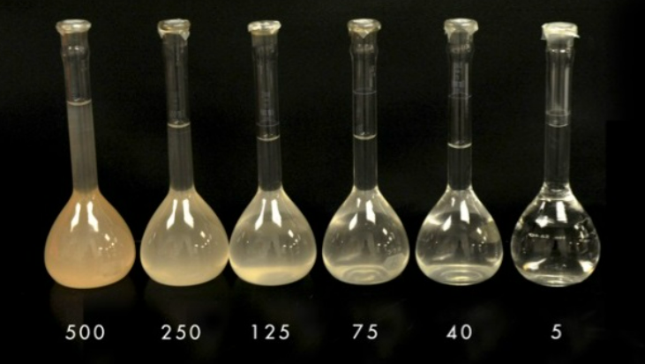
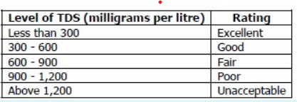
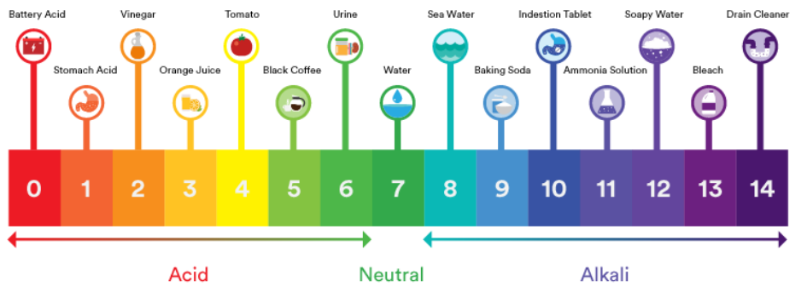
VALUES FROM SENSORS
Turbidity
TDS sensor
pH sensor
2/15/2022

Slide 8
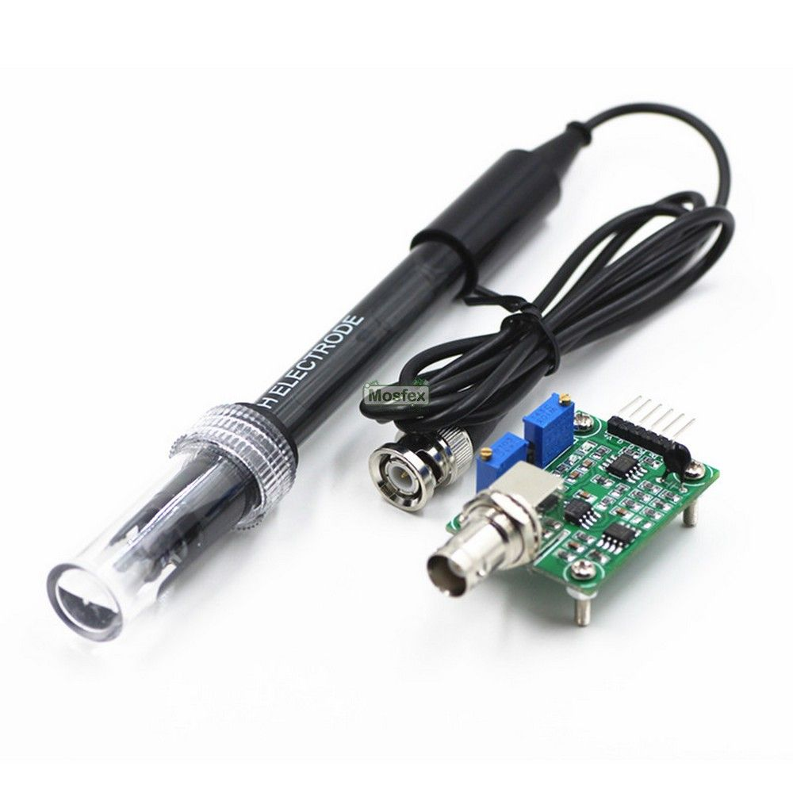
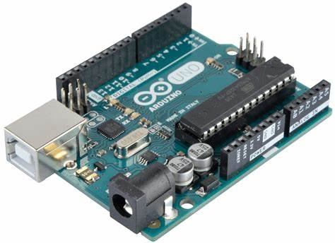
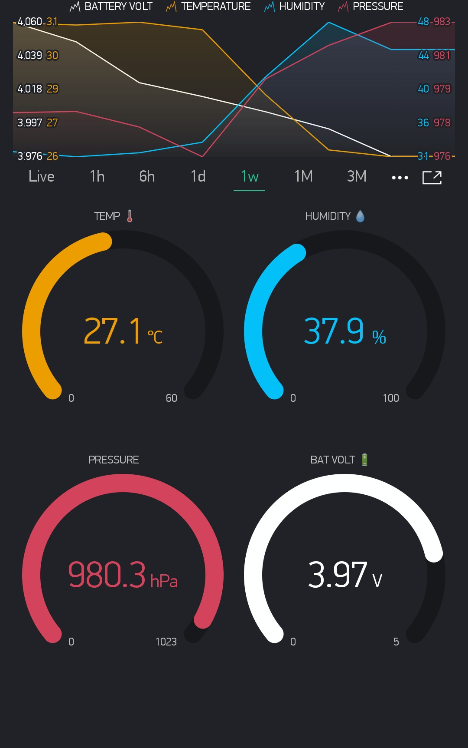
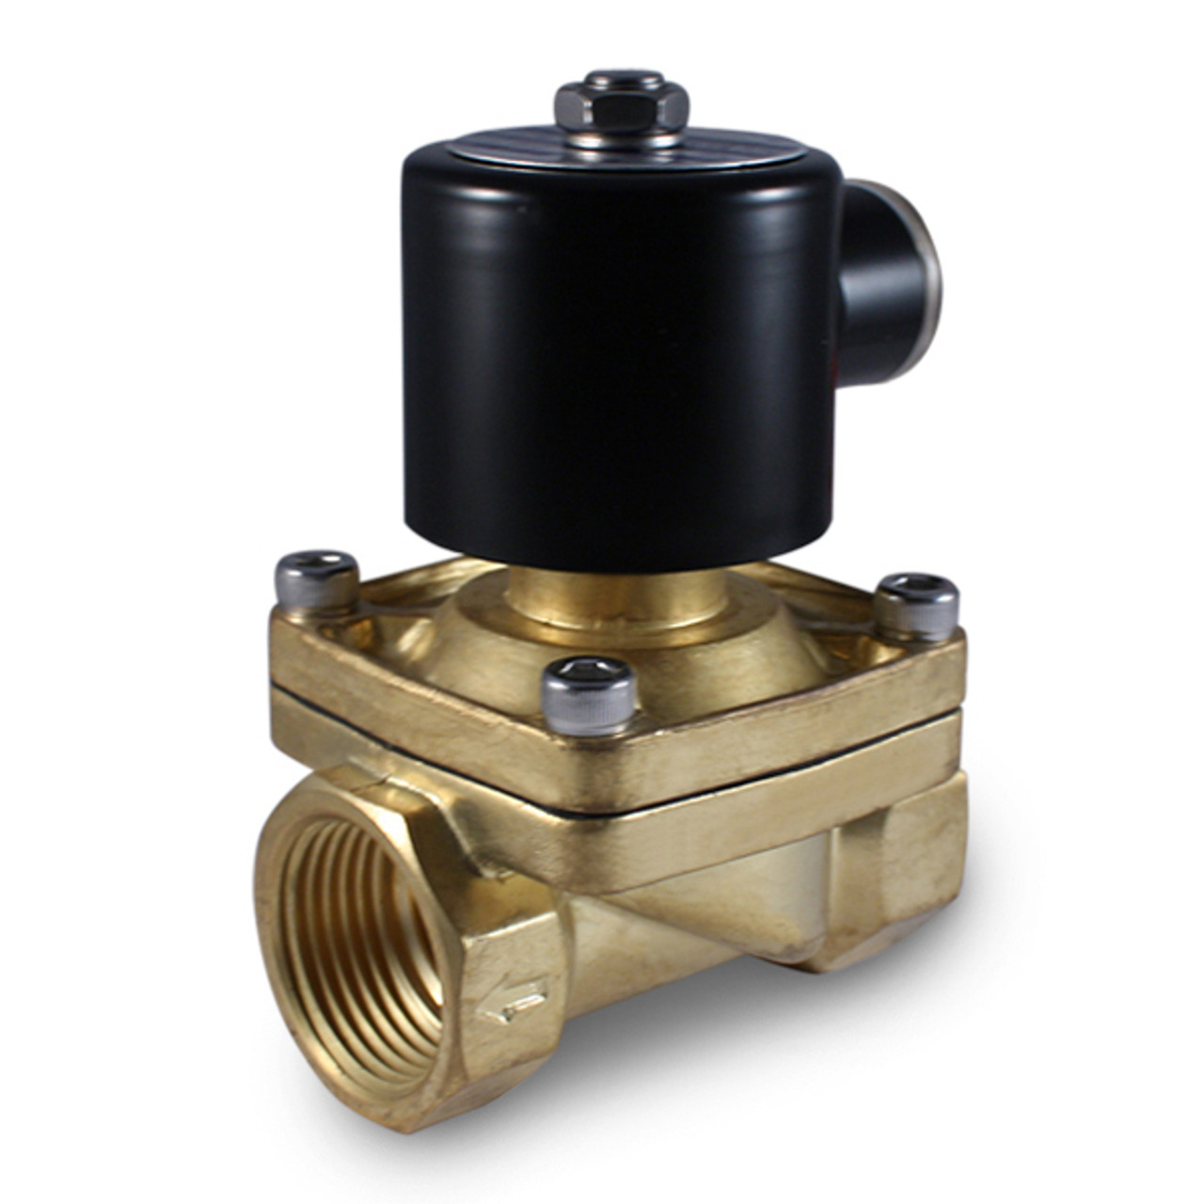
DATAFLOW
SENSORS
ARDUINO
BLYNK
ACTUATORS
2/15/2022

Slide 9
TARGETED CLIENTS
Target Market 1
APARTMENT COMPLEXES
Target Market 2
Small and MSME Industries
In urban apartment complexes there are multiple tanks that use water from varying sources and need a method to know if its up-to standards
There is a need to properly control the water that is disposed into sewers and rivers . Since these industries cannot afford high cost solutions this ad-hoc method will be effective
2/15/2022

Slide 10
References
Documnetation: https://docs.arduino.cc/
IEEE Project: https://ieeexplore.ieee.org/document/8480963
Blynk documentation:https://docs.blynk.io/en/getting-started/how-to-display-any-sensor-data-in-blynk-app
Arduino sensor documentation:
https://www.arduino.cc/reference/en/libraries/category/sensors/
Tinkercad for online assembly :https://www.tinkercad.com/
2/15/2022

Slide 11
Thank you
2/15/2022

